Slide 1




Structural and chemical characterization of epitaxial layers
P. Vennéguès
Centre de Recherche sur l’Hétéroépitaxie et ses Applications
UMR7073
Sophia Antipolis

Slide 2
Structural and chemical characterization of epitaxial layers
P. Vennéguès
Centre de Recherche sur l’Hétéroépitaxie et ses Applications
UMR7073
Sophia Antipolis

Slide 3


Introduction
CRHEA:
      8 molecular beam epitaxy reactors
      6 Metalorganic vapor phase epitaxy reactors
      Studied materials:
        III-N (GaN, AlN , InN, ….)
        ZnO-based
        SiC
        2D: graphene, TMDs…
        halogenated perovskites (Cs(Pb/Sn)Br type)
        II-N
CAT team (Advanced characterization and Technology)

Slide 4
Introduction
Ex-situ characterization of heteroepitaxial layers by « routine » technics accessible in a material lab
2 levels: « basic » characterizations ; « advanced » characterizations
Examples of characterizations mainly based on materials elaborated in CRHEA

Slide 5
Plan
Atomic force microscopy (AFM)
Scanning electron microscopy (SEM)
X-Ray diffraction (XRD)
Transmission electron microscopy (TEM)

Slide 6
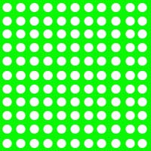

Introduction
I_{x1y1}(ϕ)
I_{x1y1}(ϕ)
y
Scanning probe microscopies:
AFM
SEM
STEM
y₁
y₁
x₁
x₁
x
sample
image
Fixed probe
Fixed probe:
XRD
TEM
sample
image
spectrum

Slide 7
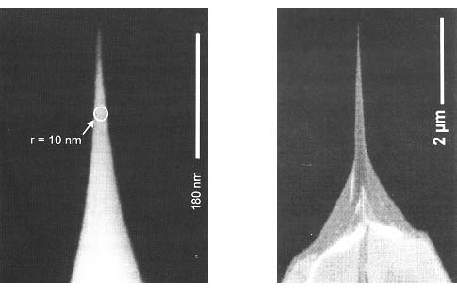
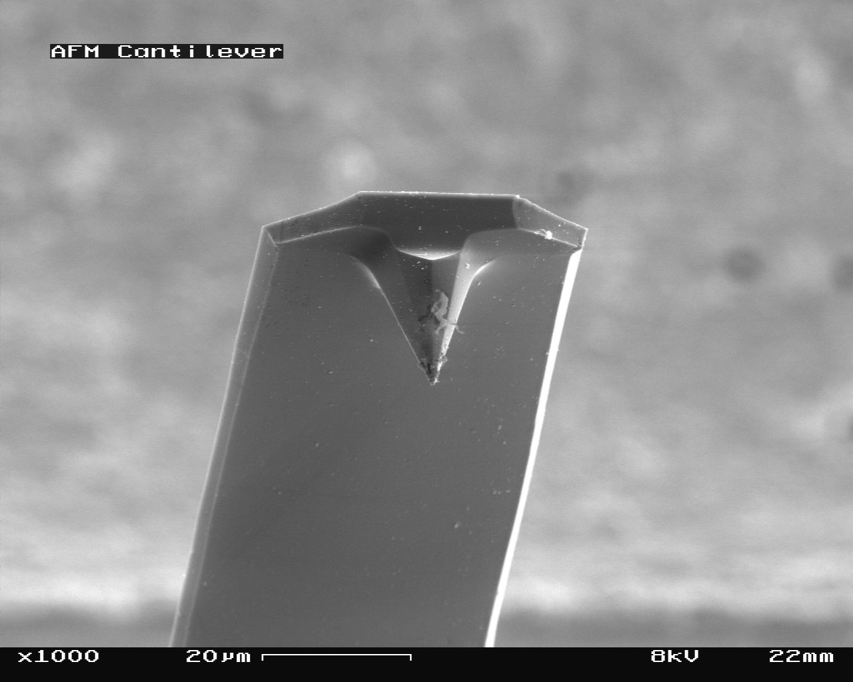
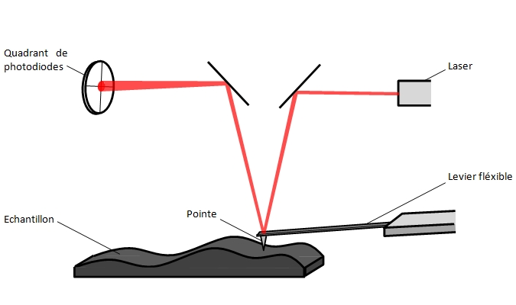
Atomic force microscopy
A. Courville: aimeric.courville@crhea.cnrs.fr
F. Bartoli: florian.bartoli@crhea.cnrs.fr
Si or SiN tip
10-15µm
Apex qq nm
https://culturesciences.chimie.ens.fr/thematiques/chimie-analytique/la-microscopie-a-force-atomique-pour-l-observation-de-molecules-avec
https://www.afmworkshop.com/
https://chem.libretexts.org/Bookshelves/Analytical_Chemistry/Supplemental_Modules_(Analytical_Chemistry)/Microscopy/Scanning_Probe_Microscopy/03_Basic_Theory/02_Atomic_Force_Microscopy_(AFM)

Slide 8
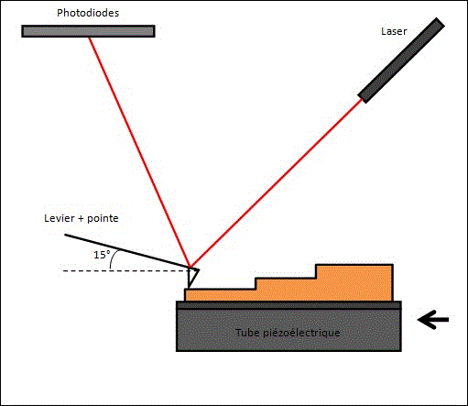
Atomic force microscopy
Contact mode:
Uses repulsive forces between tip and sample
Piezoelectric element maintains constant tip-to-sample distance
Sensitive to surface contamination: loss of resolution
Possible damage to tip

Slide 9

Atomic force microscopy
Tapping mode (tapping):
Uses repulsive forces between tip and sample
Periodic vibration of tip-sample distance
Variation of oscillation amplitude: image
High resolution
Preserved tip

Slide 10
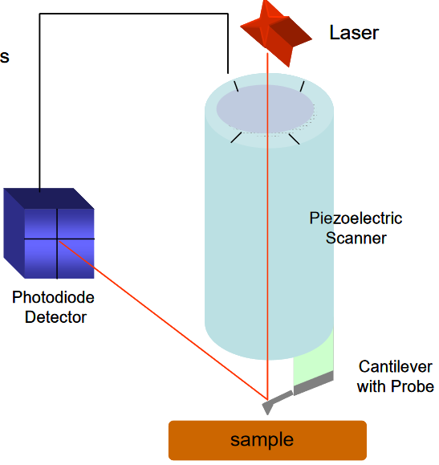
Atomic force microscopy
Piezoelectric module:
X-Y displacement (scanning)
Z displacement

Slide 11
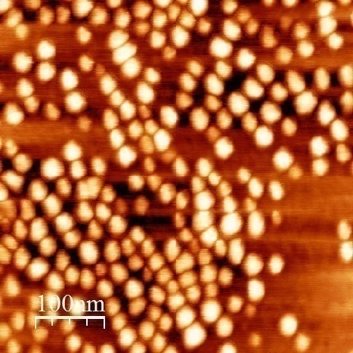
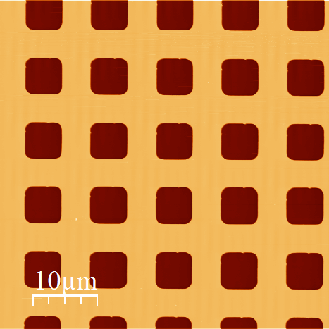
Atomic force microscopy
X = 100 μm
X = 0,5 μm
Z = 5 nm
Z = 250 nm
Y = 0,5 μm
Y = 100 μm
Calibration Si grid:
(X,Y) = 10000 μm^{2;} Z = 0,25 μm
GaN quantum dots
(X,Y) = 0,25 μm^{2;} Z = 5 nm
Field of view: 100µmx100µm to 0,5µmx0,5µm
Résolution: lateral, a few nm; vertical, a few 10pm
a few 10pm

Slide 12
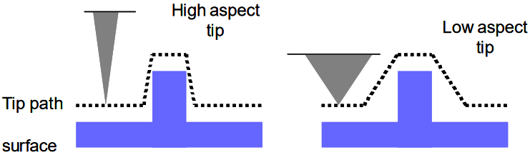
Atomic force microscopy
Possible artefacts for 3D objects

Slide 13
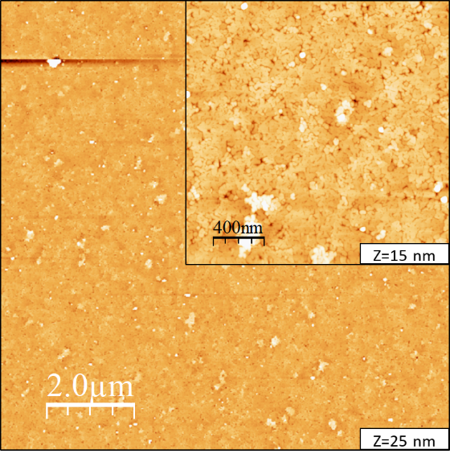
Atomic force microscopy
Face to face annealing of a AlN/BN/sapphire
Rms: 2nm
Rms: 1,2nm
“basic” use of AFM to optimize the elaboration of heteroepitaxial layers
A. Zaiter et al, Materials 2022, 15, 8602.

Slide 14
Atomic force microscopy
Determination of dislocation density in III-N
Example of GaN MOVPE on sapphire
r
surface tension
r = (b²μ)/(8π²γ_{s})
b = Burger vector
= shear modulus
γ_{s} = surface energy
line tension
dislocation
F.C. Frank, Acta Crystallogr. 4, 497 (1951)
2 main dislocation types in III-N:
a: line ≈ vertical; edge type; b_{a}= 0.3189nm;
a+c: line ≈ vertical; mixed type; b_{a+c}=0.5185nm

Slide 15
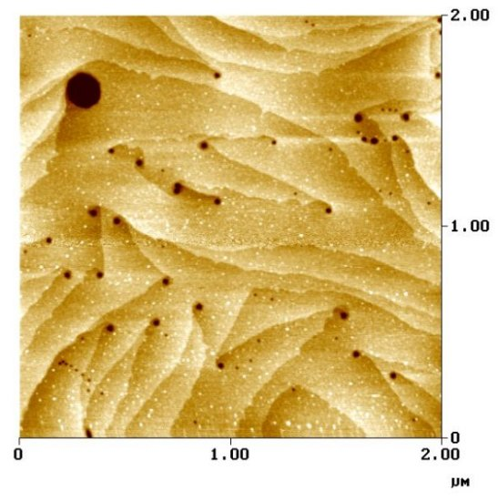
Atomic force microscopy
Determination of dislocation density in III-N
Example of GaN MOVPE on sapphire
a+c-type dislocations; screw component=>2 atomic planes terminations
a-type dislocations
?: dislocation with b>b_{a+c}; 4 atomic planes terminations; b= 2c or b=a+2c

Slide 16
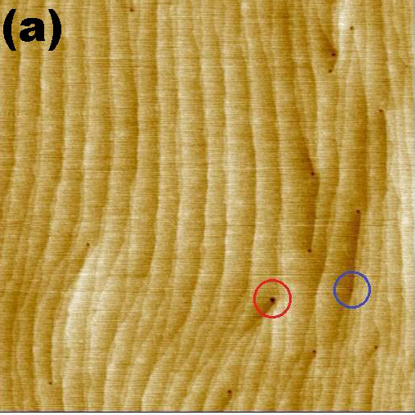
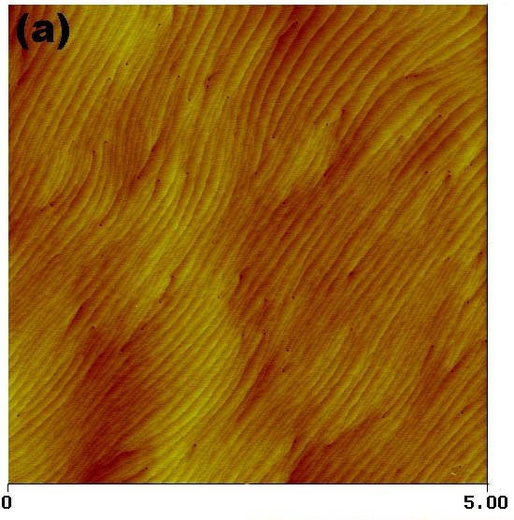
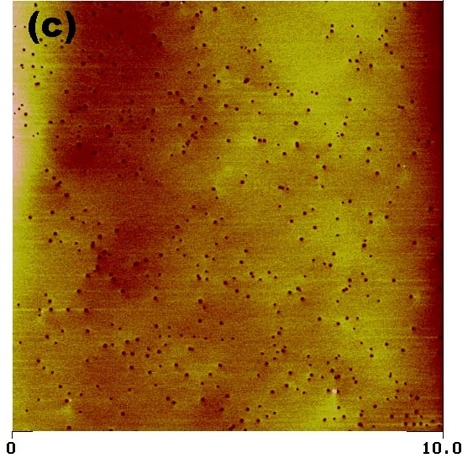
Atomic force microscopy
Determination of dislocation density in III-N
Example of GaN MOVPE on sapphire
2µm
1’ annealing at 1060°C under SiH₄ et NH₃
R.A. Oliver et al. 2006 J. Cryst. Growth. 289, 506
M. Khoury et al., Semicond. Sci. Technol. 28 (2013) 035006

Slide 17
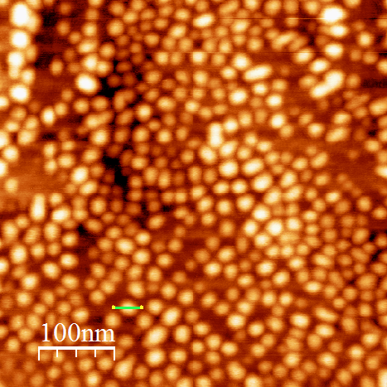
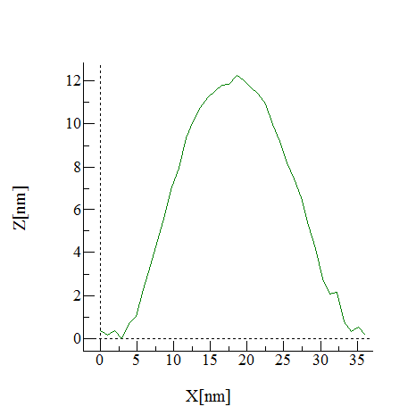
Atomic force microscopy
Quantum dots GaN/AlN/ sapphire
Height: 12nm, width: 32nm

Slide 18
Atomic force microscopy
Different stages of the growth of Graphene on SiC
thèse Chiara Mastropasqua U. Côte d’azur
C. Mastropasqua et al., npj 2D Materials and Applications | (2025) 9:32

Slide 19
Atomic force microscopy
+
Easy to use: Relatively short training
Air observation
Fast
High resolution, especially in Z (qq 10 pm)
-
Possible artifacts: limit to very smooth samples
Information limited to surface topography

Slide 20
Atomic force microscopy
GaN NH₃-MBE
As-grown
15’ annealing at 1000°C under NH₃

Slide 21
Atomic force microscopy
Force Modulation (FM) Microscopy
Lateral Force Microscopy (LFM)
Force-distance (F vs d) Measurements
Conductive Atomic Force Microscopy (C-AFM)
Piezoresponse Force Microscopy (PFM)
Electrostatic Force Microscopy (EFM)
Scanning Capacitance Microscopy (SCM)
Scanning Spreading Resistance Microscopy (SSRM)
Magnetic Force Microscopy (MFM)
Kelvin Probe Force Microscopy (KPFM)
….
Measuring the elastic properties of surfaces
Required a conductive tip: metal-coated tip => loss of resolution

Slide 22
Atomic force microscopy
Force Modulation (FM) Microscopy
Lateral Force Microscopy (LFM)
Force-distance (F vs d) Measurements
Conductive Atomic Force Microscopy (C-AFM)
Piezoresponse Force Microscopy (PFM)
Electrostatic Force Microscopy (EFM)
Scanning Capacitance Microscopy (SCM)
Scanning Spreading Resistance Microscopy (SSRM)
Magnetic Force Microscopy (MFM)
Kelvin Probe Force Microscopy (KPFM)
….
Measuring the elastic properties of surfaces
Required a conductive tip: metal-coated tip => loss of resolution
https://www.bruker.com/en/products-and-solutions/microscopes/materials-afm/resource-library/e-book-the-definitive-afm-modes-handbook.html

Slide 23
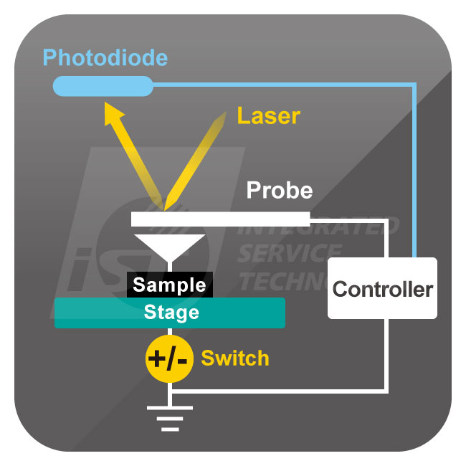
Atomic force microscopy
C-AFM (conductive AFM)
AFM in contact mode
Simultaneous acquisition of a topographic image and an electrical conduction image
With a fixed probe, I(V) measurements can be taken by varying the applied voltage

Slide 24
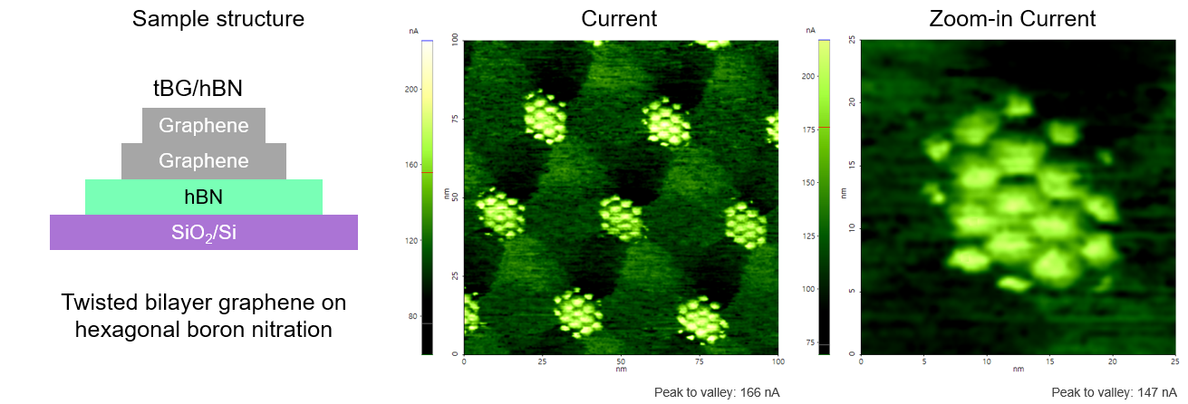
Atomic force microscopy
C-AFM (conductive AFM)
https://www.parksystems.com/en/learning-center/lc-detail.learning875

Slide 25
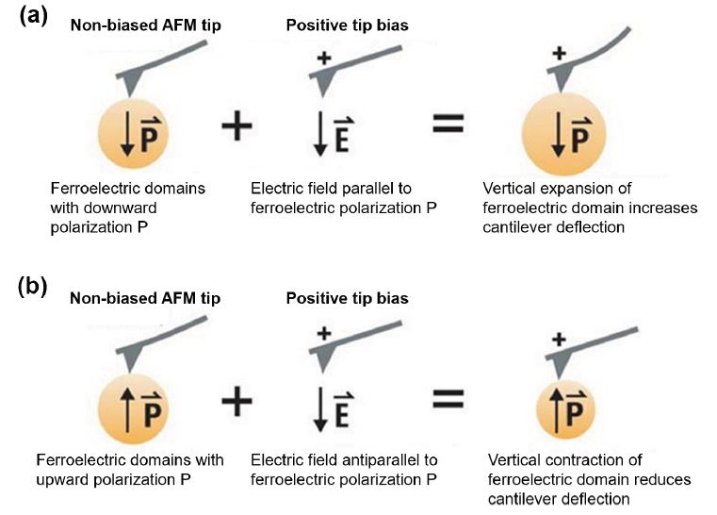
Atomic force microscopy
PFM (Piezoresponse force microscopy)
Contact mode
Mapping of polarity domains
Polarity can be reversed by applying a sufficiently large field (ferroelectric materials)

Slide 26
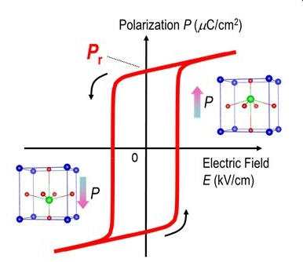
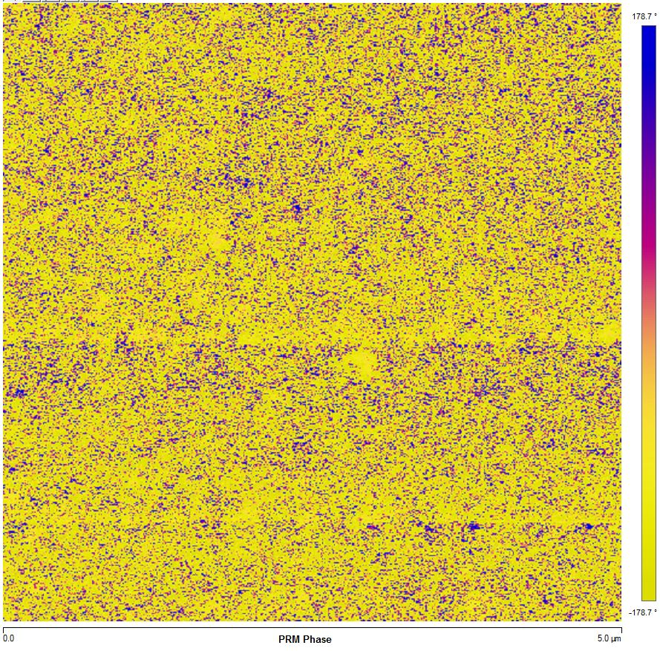
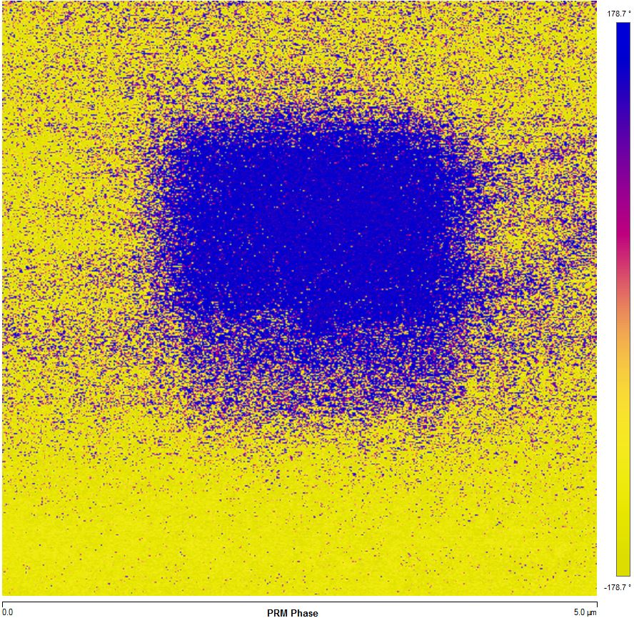
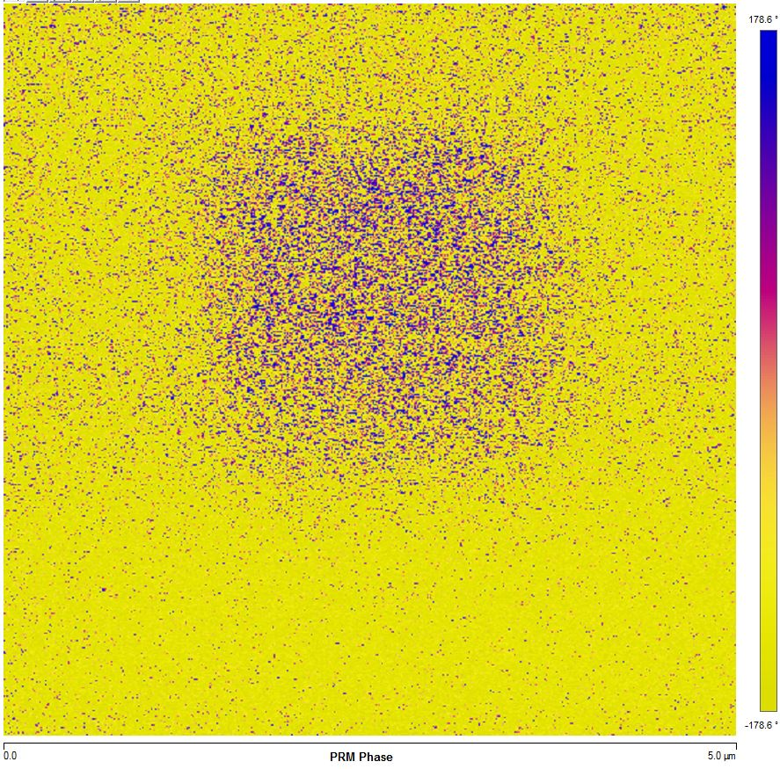
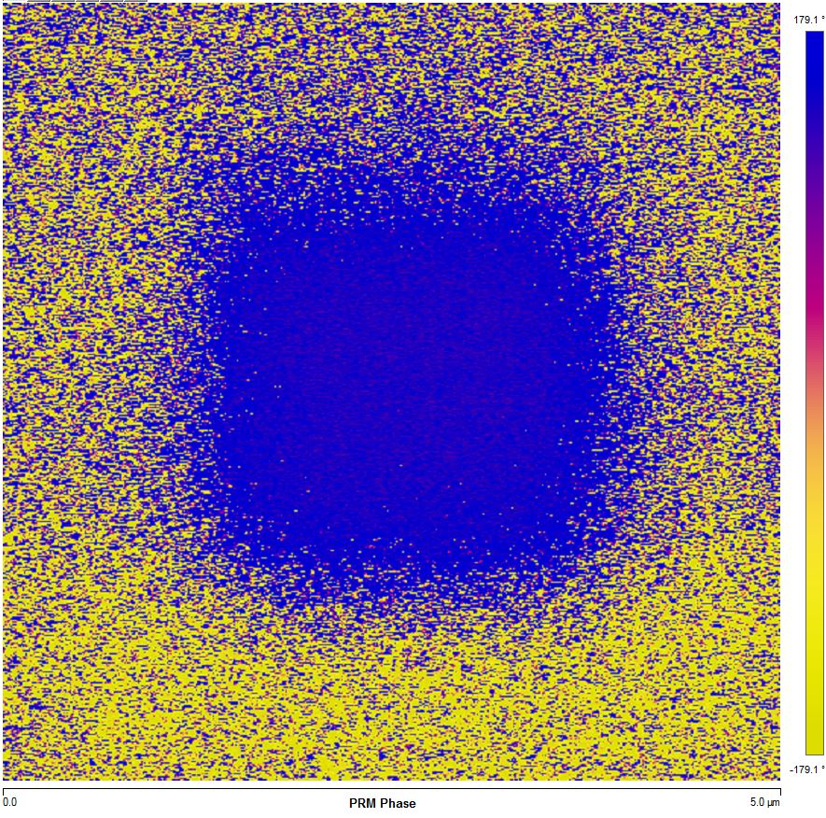
Atomic force microscopy
PFM (Piezoresponse force microscopy)
Ferroelectric effect in HfO₂
Initial step
-6V
+6V
-6V

Slide 27
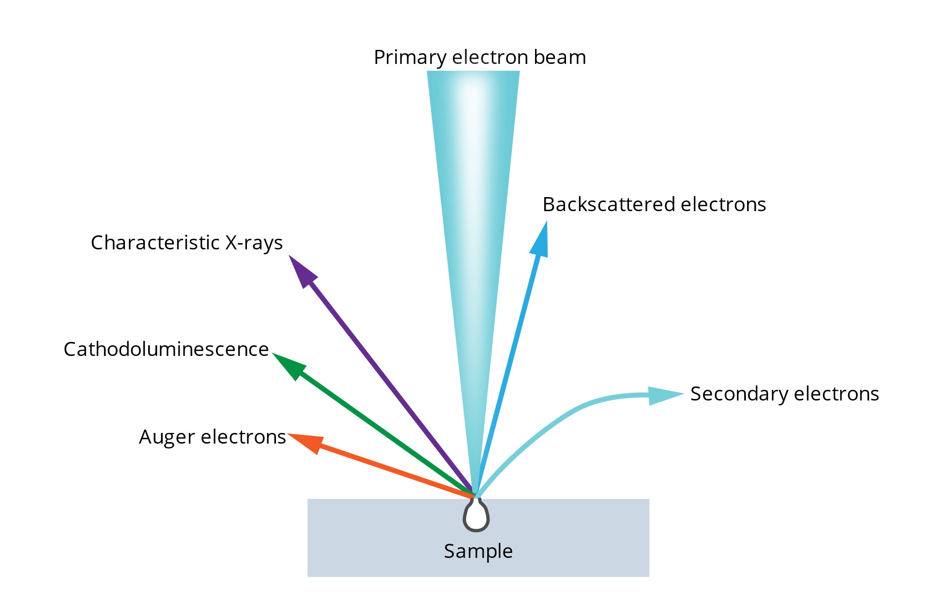
Scanning Electron Microscopy
https://www.globalsino.com/EM/; https://myscope.training/SEM_SEM_Basics
V. Brandli: virginie.brandli@crhea.cnrs.fr
I_{x1y1}(ϕ)
y
y₁
x₁
x
sample
image
Probe: focus electron beam=> HT (500meV to 30kV) and I can be tuned
SE: topography contrast
BSE: chemical contrast
X-rays: composition maps
CL: optical properties map

Slide 28
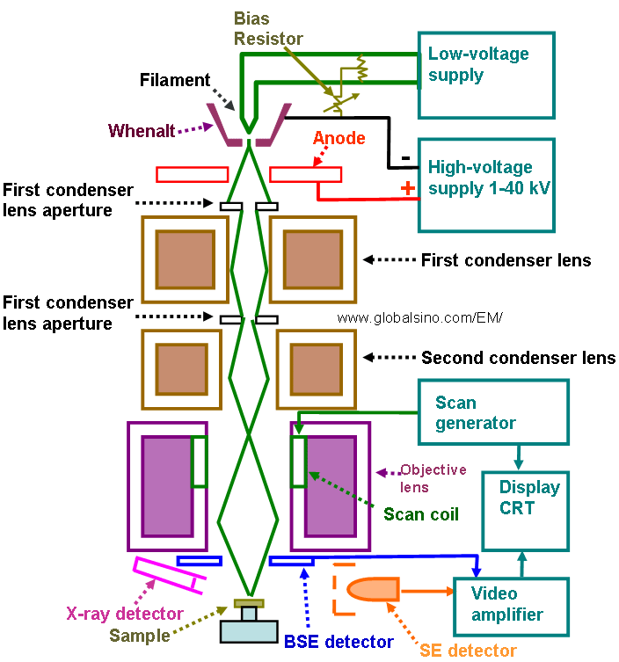
Scanning Electron Microscopy
Emitter stage
Emission and acceleration of e⁻
Under vacuum
Condenser stage
Shaping the beam
Objective stage
Focusing the beam
Scanning the beam
Sample stage
Sample and detectors

Slide 29
Scanning Electron Microscopy
Non destructive technique
Possibility to analyze large and thick samples (full wafer)
large range of magnification: x10 to x2M
Tilt and rotation of the samples
No sample preparation required except:
  For insulating samples: coating with Au or C
  For cross section observations (layers thickness measurement)
Under vacuum

Slide 30
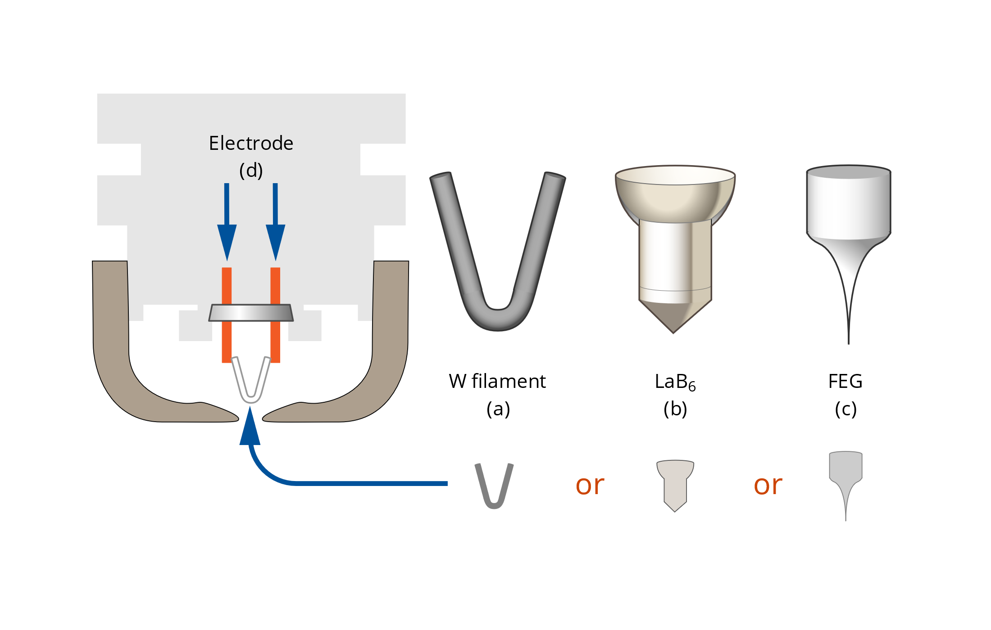
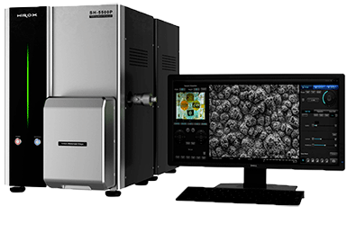
Scanning Electron Microscopy
Emitter
Thermionic emitters: W or LaB₆ filaments
Field emission gun emitters:
  Cold FEG: high brightness, small beam
  Schottky FEG: high current, more versatile
Table top SEM

Slide 31
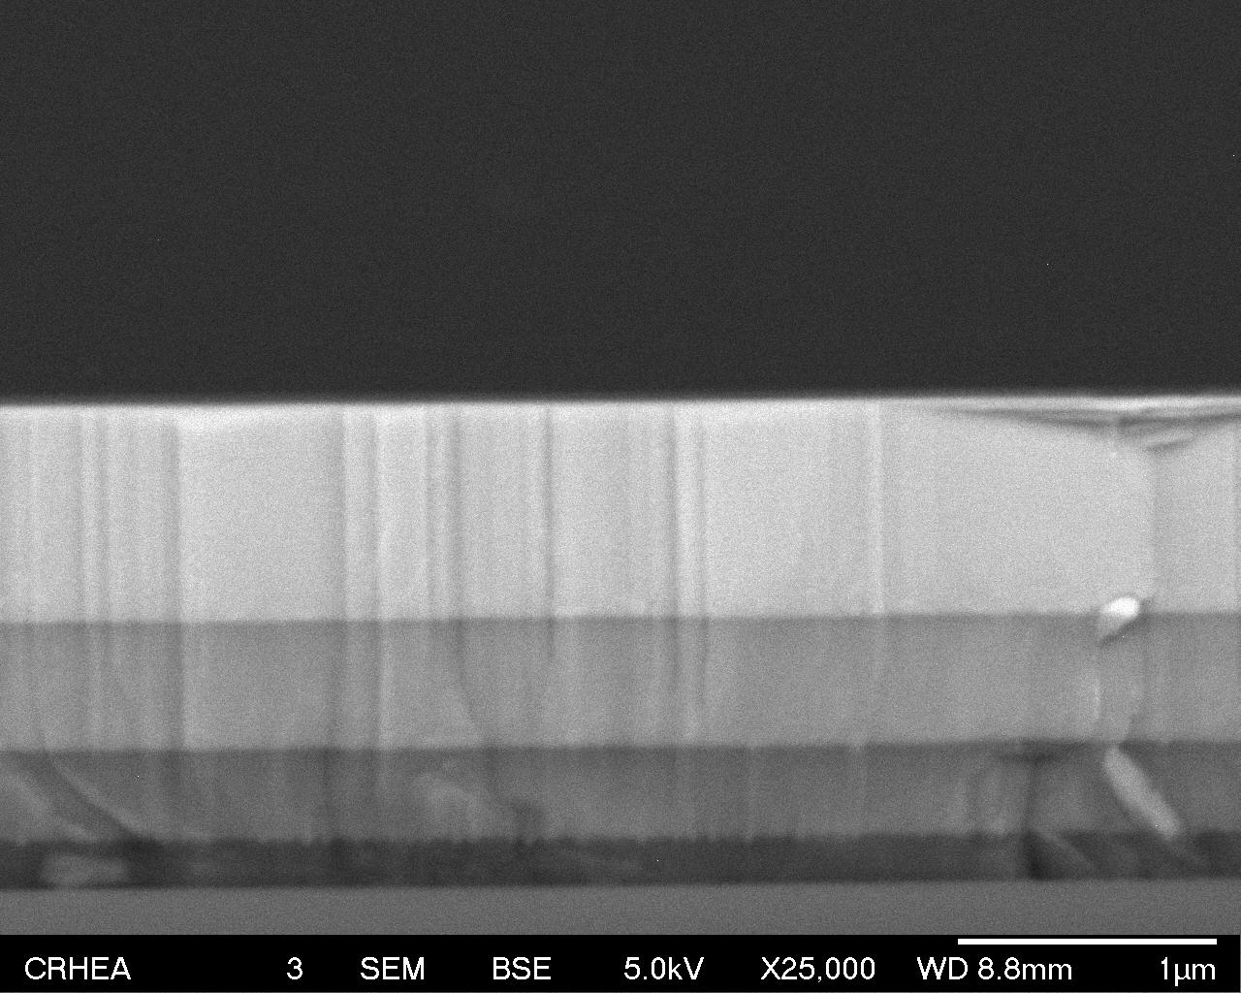
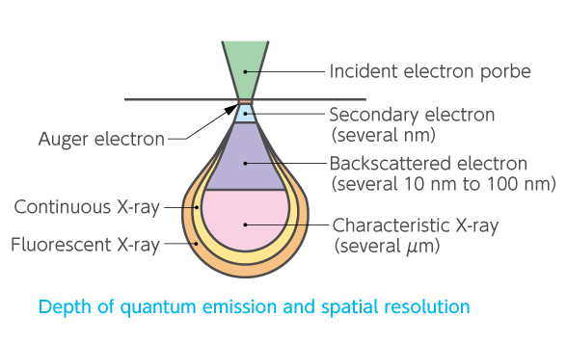
Scanning Electron Microscopy
Elastic interactions:
BSE: chemical contrast; resolution defined by probe size and interaction volume: 10-100nm
AlGaN₃
AlGaN₂
Inelastic interactions:
SE
X-rays
Optical emission (CL)
AlGaN₁
AlN
Si
Interaction volume
Depends on HT and material

Slide 32
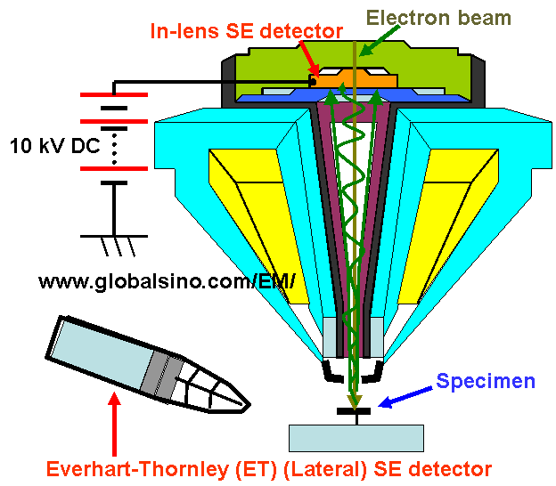
Scanning Electron Microscopy
Secondary electrons
<50V
Comes from the top surface of the specimen (a few nm)
Contrast related to the surface topography
Resolution defined by probe size and interaction volume:
    HT=> probe size: improvement of resolution
    HT => interaction volume: deterioration of resolution
    HT => more BSE detected in the SE detector: use of in-lens detector
Resolution: trade off between different parameters and is sample dependent; down to <1nm

Slide 33
Scanning Electron Microscopy
Low WD (a few mm):
highly convergent beam: high resolution
Limited depth of field
Problem with 3D samples; tilting ….
Less space for detectors (EDS, CL…)
Large WD (<10mm):
More parallel beam: limited resolution
High depth of field
Possibility to observe 3D samples and to tilt the samples
Introduction of different kinds of detectors

Slide 34
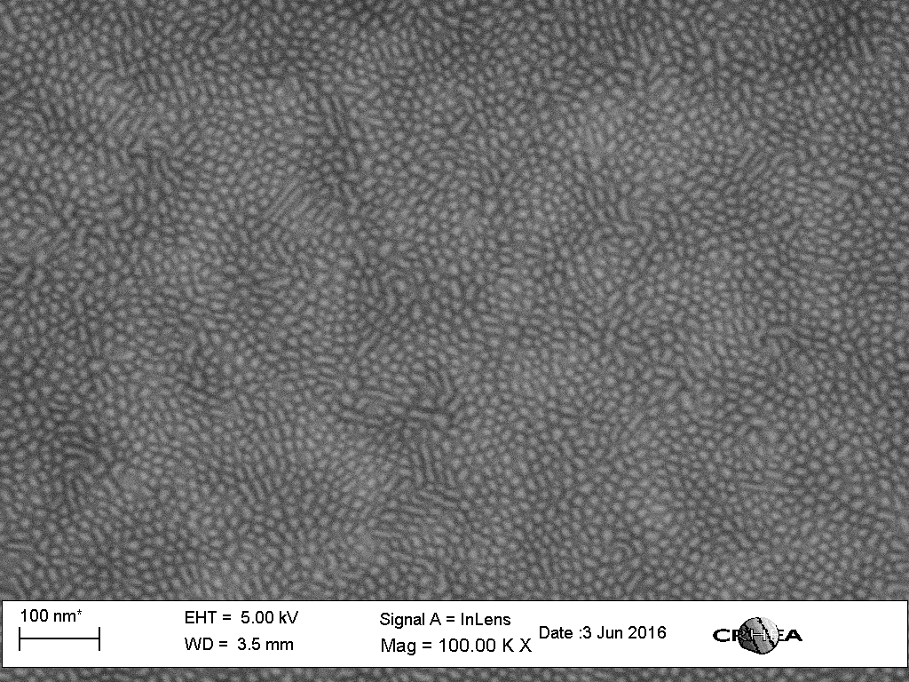
Scanning Electron Microscopy
small WD
GaN QD/AlN

Slide 35
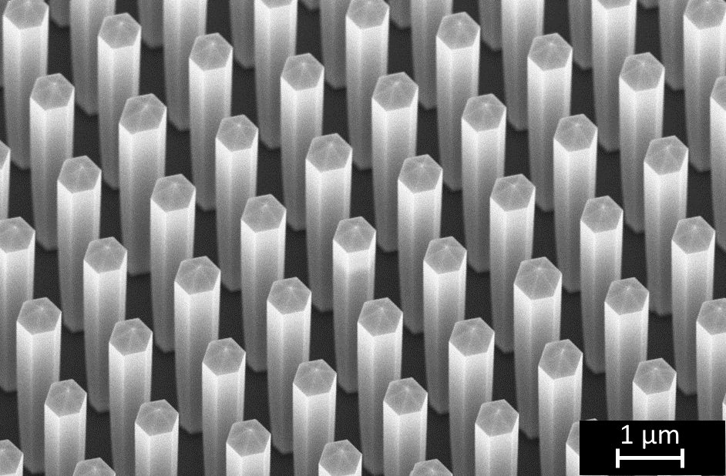
Scanning Electron Microscopy
Large WD
SEM very well adapted to the study of 3D µ- and nano-objects

Slide 36
Scanning Electron Microscopy
AlGaN µ-object on sapphire
Charging problems:
  Coating with conductive layer (C, Au…)
  Low HT
  Low vacuum (small gas flow on the sample surface)

Slide 37
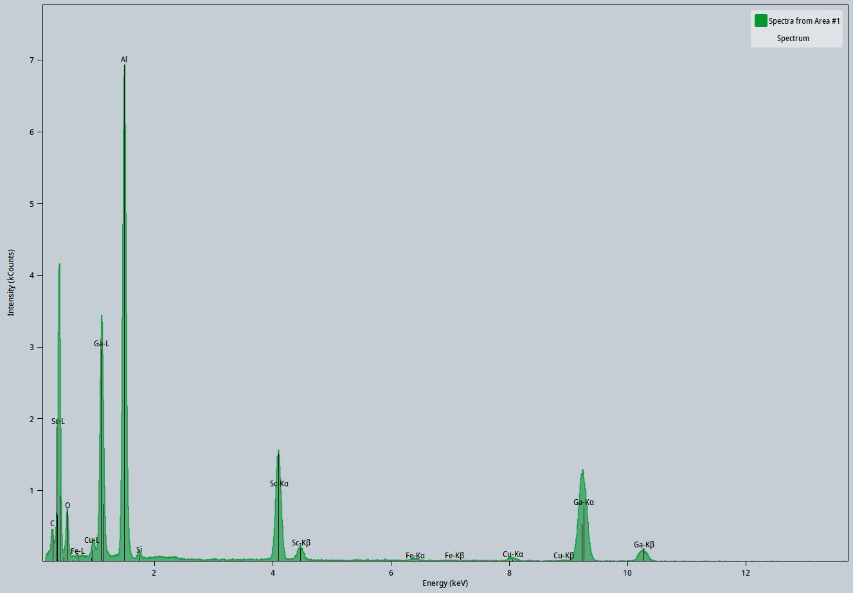
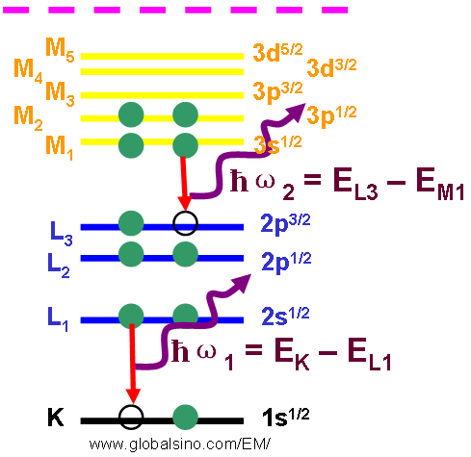
Scanning Electron Microscopy
X-Rays: when an incident e⁻ ionized an atom, it returns to its ground state by emitting characteristic X Rays
AlGaScN
Wavelength-dispersive spectrometer (WDS): highly sensitive but requires a dedicated instrument
Energy-sensitive spectrometer (EDS or EDX): solid state detector capable of analyzing X-ray energies

Slide 38
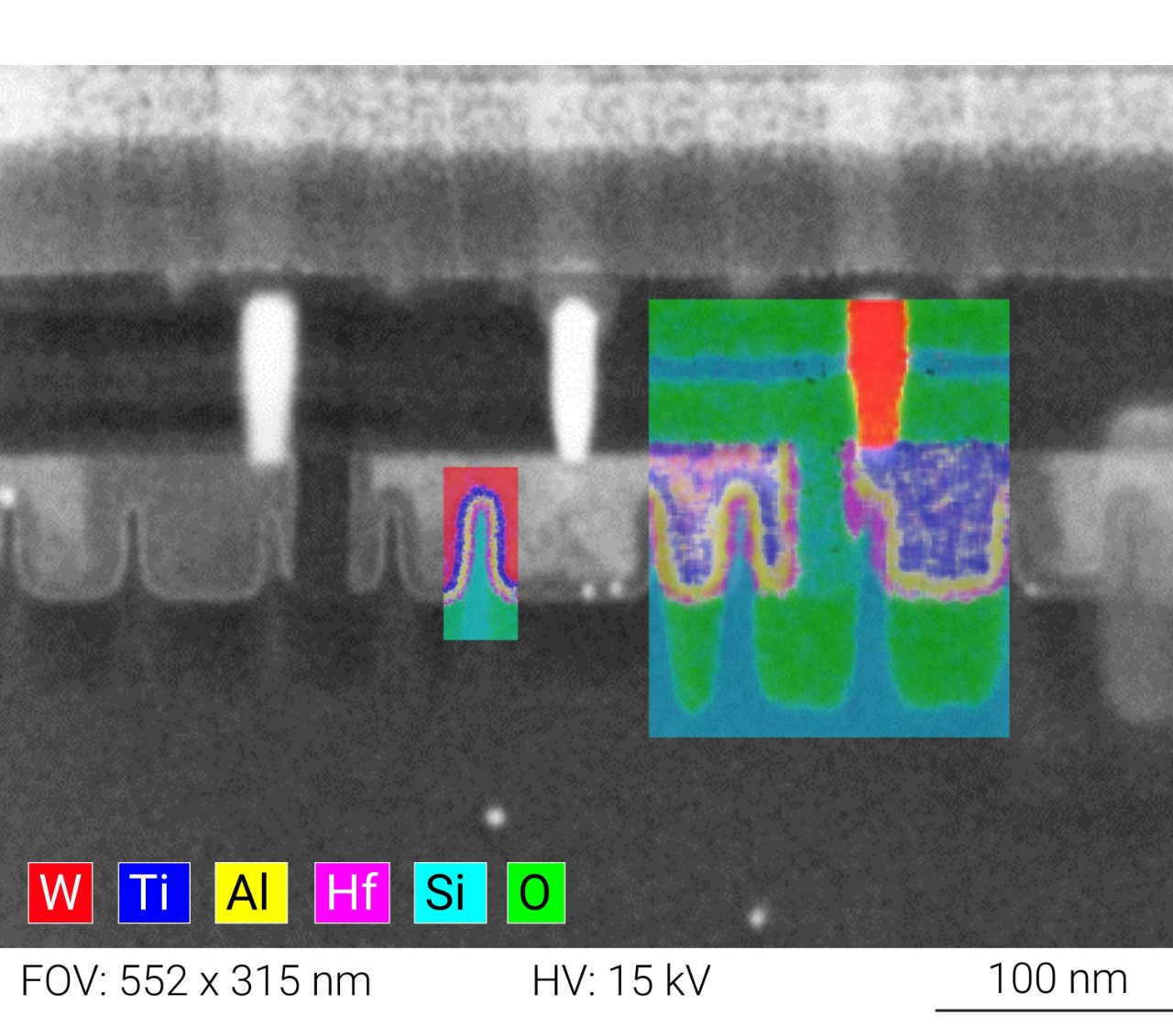
Scanning Electron Microscopy
EDS
Simultaneous e⁻ image and EDS maps of a semiconductor device in cross section
Bruker

Slide 39
Scanning Electron Microscopy
EDS quantitative analysis: use of standards (sample with same elements of known concentration)
Semiquantitative analysis: comparison with standards from a library
Quantitative analysis: standards acquired with the same microscope and the same acquisition parameters; corrections to be applied:
  Z: corrections relying the mean Z number of the sample
  A: absorption
  F: fluorescence
Quantitative composition determination by EDS is not straightforward
a few % precision
Not usable for light elements (Z<11)

Slide 40
Scanning Electron Microscopy
Quantitative EDX for adjusting growth parameters of alloys (AlGaN)
layer
layer
substrate
substrate
Decrease HT
Increase layer thickness
Casino sotfware

Slide 41
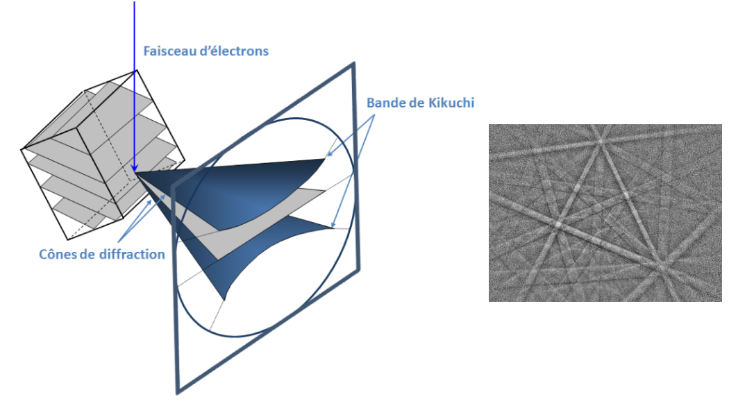
Scanning Electron Microscopy
BSE may be diffracted by the crystalline lattice of the sample
e⁻ beam
Kikuchi bands
Electron backscattered diffraction
EBSD
Diffraction cones
Kikuchi pattern
https://mea.edu.umontpellier.fr/ebsd/ebsd-principe/
Analysis of Kikuchi patterns and comparison to calculated patterns allow obtaining:
  Phase map
  Orientation map
Popular for polycrystalline materials (metals) but thanks to improvement of resolution (spatial ≈ nm and angle <0.1°) EBSD may be useful for heteroepitaxial layers

Slide 42
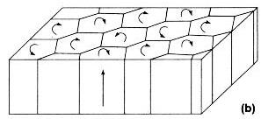
Scanning Electron Microscopy
EBSD
III-N heteroepitaxial microstructures
GaN
SiO₂
F.A. Ponce Group III Nitride Semiconductor Compounds, Physics and Applications (Clarendon Press, Oxford 1998).
Dislocations in the domains boundaries to compensate the misorientations
R. Dagher et al, J. Cryst. Growth, 526, 2019, 525235
K. Baril et al., J. Appl. Phys., 133, 245702, (2023)

Slide 43
Scanning Electron Microscopy
EBSD
Reduction of misorientations between adjacent pillars forming different groups
K. Baril, PHD U. Côte d’Azur
M. Wehbe et al., J. Appl. Phys. 136, 224302 (2024)

Slide 44
Scanning Electron Microscopy
Electron channeling contrast imaging ECCI
Revealing crystal imperfection thanks to local variations of diffraction conditions (see TEM chapter)
sonde
G. Naresh-Kumar et al., Materials Science in Semiconductor Processing, 47(2016)44–50

Slide 45
Scanning Electron Microscopy
ECCI
Gradual relaxation of AlSb on GaSb with the introduction of misfit dislocations (MBE)
PHD Audrey Gilbert, U. Montpellier

Slide 46
Scanning Electron Microscopy
Cathodoluminescence CL
Advantages as compared to PL:
Study of wide bandgap materials (Al-rich AlGaN alloys; AlN bandgap≈ 6.2eV )
Spatial resolution
CL modes:
  panchromatic: using all the emitted light to create images
  Hyper spectral analysis

Slide 47
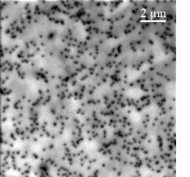
Scanning Electron Microscopy
CL
Panchromatic image
MOVPE GaN
M. Khoury et al. Semicond. Sci. Technol. 28 (2013) 035006
K. Baril, PHD U. Côte d’Azur
Dislocation are non-radiative carriers recombination centers => they appear as dark spots on a emitting (bright) matrix
Useful to determine dislocations densities in high crystalline quality layers

Slide 48
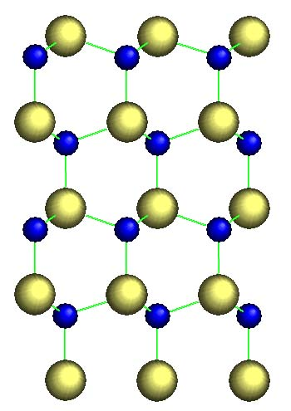
Scanning Electron Microscopy
CL
Hyperspectral analysis
MOVPE GaN µwire on sapphire
N-polarity
Ga-polarity
b
B
a: N
A: Ga
TEM image
P.M. Coulon et al., J. Appl. Phys. 115, 153504 (2014)

Slide 49
X-Ray diffraction
Maud Nemoz: maud.Nemoz@crhea.cnrs.fr
Maud Nemoz
Fixed probe
Typical beam size with a laboratory tool: 1cmx50µm
Typical penetration length: a few 10µm
average information on a large volume of sample
Non destructive technique
sample
image
spectrum
No lens for Xray: no image

Slide 50
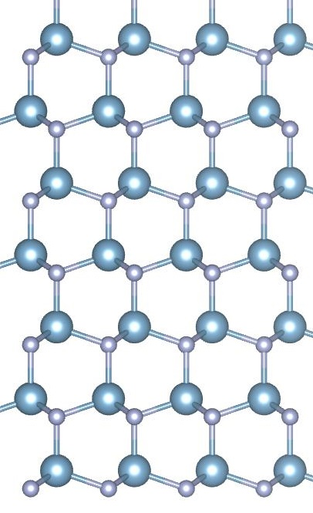
X-Ray diffraction
Xray diffraction: study of the reciprocal space
Direct space
Reciprocal space
d₍₁₋₁₀₀₎
(0004)
(1-104)
(0002)
(1-103)
d₍₀₀₀₂₎
1/d₍₀₀₀₂₎
(0002)
(1-102)
1/d₍₁₋₁₀₀₎
(1-101)
(-1100)
(1-100)
(0000)
(1-100)
(000-2)
GaN [11-20]

Slide 51
X-Ray diffraction
Xray diffraction: study of the reciprocal space based on the Bragg law
2d_{(hkl)} sin θ = nλ with d_{(hkl)} interreticular distance of hkl plane, θ diffraction angle and λ Xray wavelength
Q = k_{f} – k_{i} Q reciprocal space vector, k_{i} incident wave vector, k_{f} final wave vector
|Q | = 1/d, |k | = 1/ λ
Fixed probe
Fixed probe
sample
sample
Study of the 3D reciprocal space by varying the sample/Xray beam orientation

Slide 52
X-Ray diffraction
Xray source:
  Xray tube (e-beam hit a target which emit characteristic Xray)
  Rotating anode
Anode | Kα₁(Å)
Cu | 1.54060
Cr | 2.28970
Fe | 1.93604
Co | 1.78897
Mo | 0.70930
Characteristic emission
Xray source:
  Synchrotron radiation

Slide 53
X-Ray diffraction
Sample stage
Xray source
Slit
mirror
monochromator
diffracted beam capture
-slits
-analyzer
-detector
Incident beam condition

Slide 54
X-Ray diffraction
(0D, 1D, 2D)
To obtain a small divergence into the diffraction’s plane
Only the Kα1 can go out the monochromator
Xray source

Slide 55
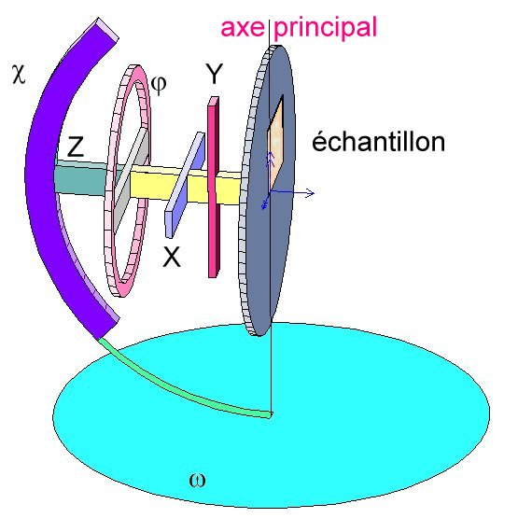
X-Ray diffraction
4 axes goniometer: allow to access any position in the 3D reciprocal space
φ

Slide 56
X-Ray diffraction
Diffraction geometries
K. Inaba et al., Advances in Materials Physics and Chemistry, 2013, 3, 72-89

Slide 57
X-Ray diffraction
θ/2θ symmetric geometry: scan of the reciprocal direction perpendicular to the sample surface: study of the planes parallel to the surface
Q_{z}
detector
Incident Xrays
2θ₂
θ₂
θ₁
2θ₁
k_{i}
k_{f}
Q_{y}

Slide 58
X-Ray diffraction
ω scan symmetric geometry: fixed detector (2θ); determination of the diffraction peak width in the Q_{y} direction (in plane)
Q_{z}
Detector(fixed)
Incident Xrays
Q_{y}
Δω
2θ₁
k_{i}
k_{d}

Slide 59
X-Ray diffraction
Asymmetric geometry: study of inclined planes
  ω/2θ: scan of a direction inclined by α to the normal of the film
  ω scan
  Combining ω/2θ and/or ω scans: 2 D reciprocal space mapping (rsm)
Q_{z}
α
Detector
ω =θ + α
Q_{y}
2θ

Slide 60
X-Ray diffraction
asymmetric
ω/2θ
rsm
ω
symmetric
GaN (1-210)

Slide 61
X-Ray diffraction
Study of epitaxial relationships: MBE-grown Mg₃N₂/MgO
φ scans (440) planes
Growth direction
(440)
(222)
Mg₃N₂ (1-10)

Slide 62
X-Ray diffraction
Study of epitaxial relationships: MBE-grown Mg₃N₂/MgO
Presence of 12 (400) peaks instead of 3 expected
Presence of rotational domains
[1-10] Mg₃N₂//[001]MgO
[11-2] Mg₃N₂ //[01-1]MgO
Plus 90°, 180° and 270° in plane rotations
P. John et al., Phys. Rev. Mat. 04, 054601 (2020)
P. John et al. J. Appl. Phys. 129, 095303 (2021)

Slide 63
X-Ray diffraction
Lattice parameters determination
a_{c}
contraction
dilatation
a_{s}
b
a_{c} > a_{s}
Coherent growth
Elastic relaxation
Incoherent growth
Plastic relaxation with introduction of misfit dislocations above a critical thickness

Slide 64
X-Ray diffraction
Lattice parameters determination
2d_{(hkl)} sin θ = nλ
θ /2θ : determination of out-of-plane lattice parameter
AlN/GaN/SiC
symmetric
GaN
AlN
SiC
The position of characteristic peaks in θ /2θ scan allow determining the strain state
GaN (1-210)

Slide 65
X-Ray diffraction
Lattice parameters determination
Q_{z}
Position of symmetric peaks (θ /2θ) : function of out-of-plane lattice parameter
Position of asymmetric peaks (ω /2θ): function of out-of-plane and in plane lattice parameters
Determination of in and out-of-plane latices parameters
Q_{y}
GaN (1-210)

Slide 66
X-Ray diffraction
Lattice parameters determination
Out-of-plane
rsm
In-plane
GaN (1-210)

Slide 67
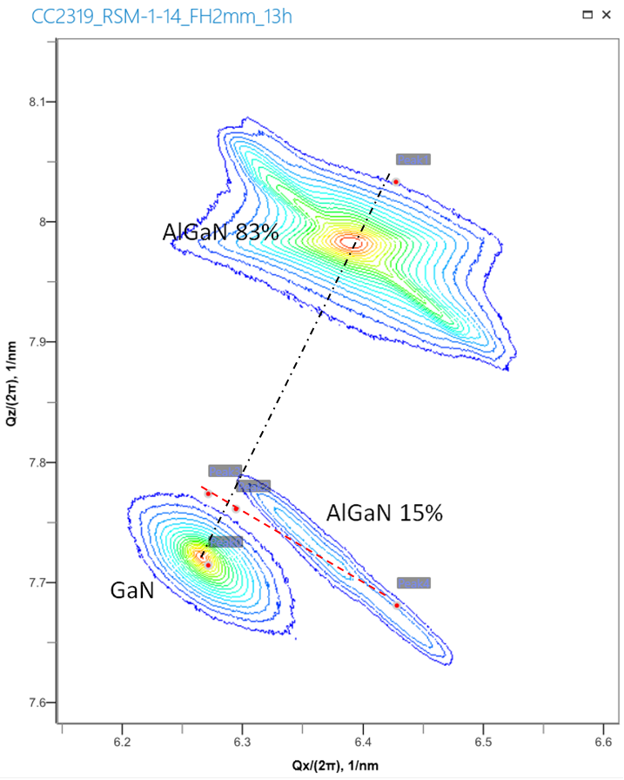
X-Ray diffraction
Lattice parameters determination
Out-of-plane
20µm
2µm
Al_{0.83}Ga_{0.17}N
Al_{0.15}Ga_{0.85}N
GaN pillar
In-plane
Al_{0.83}Ga_{0.17}N and Al_{0.15}Ga_{0.85}N have same in-plane parameters; Al_{0.83}Ga_{0.17}N fully relaxed
Compressive strain of Al_{0.15}Ga_{0.85}N on Al_{0.83}Ga_{0.17}N: out-of-plane dilatation

Slide 68
X-Ray diffraction
Crystalline quality
Mosaic model for heteroepitaxial films microstructure
lateral
coherence
Length L⎢⎢
twist angle
Q_{z}
tilt angle
Q_{x}
vertical
coherence
Length L⊥
f(1/ L⎢⎢, tilt)
f(tilt)
f(1/L⊥)
substrate
f(1/ L⎢⎢)
Q_{y}
Q_{z} = f(1/L⊥)
Q_{y} = f(1/ L⎢⎢, tilt) for symmetric peaks
Q_{x} = f(1/ L⎢⎢, twist) for asymmetric peaks

Slide 69
X-Ray diffraction
Crystalline quality
Q_{z} = f(1/ L⎢⎢, tilt) for symmetric peaks
Q_{x} = f(1/ L⎢⎢, twist) for asymmetric peaks
Tilt (twist) contribution to the peak width increases with Q_{z} whereas 1/L⎢⎢contribution is constant => Williamson-Hall plot
Q_{z}
Q_{x}
f(1/ L⎢⎢, tilt)
f(1/L⊥)
f(tilt)
f(1/ L⎢⎢)
Q_{y}
(0006)
(0004)
Typical Williamson-Hall plot
for a III-N layer (symmetric peaks)
fwhm×(sinθ)/λ
(0002)
Y = (tilt × x) + 0.9/2 L⎢⎢
(sinθ)/λ

Slide 70
X-Ray diffraction
Crystalline quality: MBE-grown Mg₃N₂/MgO
Williamson-Hall « like » plot, asymmetric peaks:
Tilt: 1,3°
Twist: 2,5°
P. John et al. J. Appl. Phys. 129, 095303 (2021)
R. Lee et al., Appl. Phys. Lett. 86, 241904 (2005)

Slide 71
X-Ray diffraction
Thickness measurement: symmetric geometry
GaNlayer
1 µm
200 nm
50 nm
Main peak
GaN (0002)
Thickness fringes
Δ2θ
Scherrer equation: t= λ/(Δ2θcos θ)

Slide 72
X-Ray diffraction
Thickness measurement: reflectivity (MBE-grown Mg₃N₂/MgO)
From best fit:
Mg₃N₂= 98nm
MgO= 42nm
Interface roughness= 1nm
Mg₃N₂ density= 2.56 g cm⁻³

Slide 73
Transmission Electron Microscopy
I. Florea
Transmission electron microscopy:
    Requires a 0 to a few hundred nm-thick sample => sample preparation
Plan view (PV)
Cross section (CS)
- “classical” preparation: cutting, gluing, polishing and ion thinning; both CS et PV; time consuming, manual skills, non localized, high quality very thin samples
- Focus ion beam

Slide 74
Transmission Electron Microscopy
I. Florea
Transmission electron microscopy:
    Requires a 0 to a few hundred nm-thick sample
Plan view (PV)
Cross section (CS)
- “classical” preparation: cutting, gluing, polishing and ion thinning; both CS et PV; time consuming, manual skills, non localized, high quality very thin samples
- Focus ion beam: CS; quick (1/2 day/sample), partially automatic, localized; amorphous surface layer, expensive
Destructive technic

Slide 75
Transmission Electron Microscopy
Transmission electron microscopy
Scanning transmission electron microscopy
“large” parallel beam on the sample
“small” convergent beam on the sample
Fixed probe
y
I_{x1y1}(ϕ)
sample
y₁
image
x₁
x
image
sample

Slide 76
Transmission Electron Microscopy
Transmission electron microscopy
Objective lens focus plane: diffraction
image

Slide 77
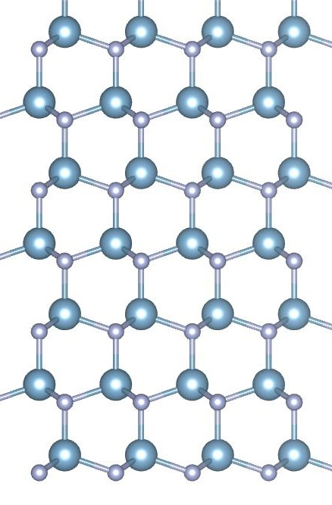
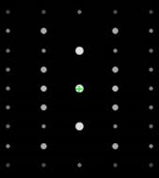
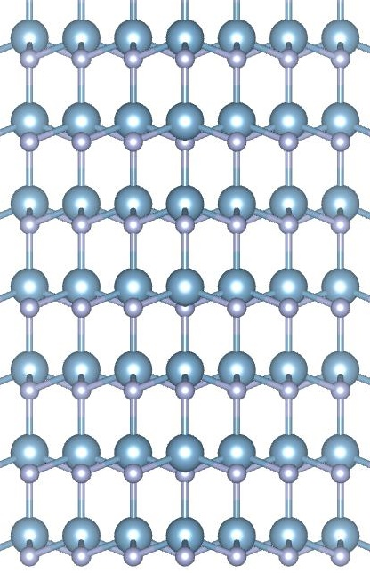
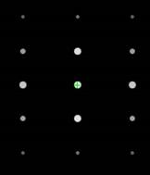
Transmission Electron Microscopy
Electron diffraction
(0002)
(10-10)
GaN [11-20] zone axis
Check of the mono-crystallinity of the layer
(0002)
(11-20)
GaN [10-10] zone axis

Slide 78

Transmission Electron Microscopy
Electron diffraction
Determination of epitaxial relationship
ZnO on R-plane: sapphire in black, ZnO in gray
[1−100]_{ZnO}// [11−20]_{sap} et [0001]_{ZnO}// [−1101]_{sap}
P. Vennéguès et al., J. Appl. Phys. , 103, 083525 (2008)
Polarity determination by convergent beam electron diffraction
c
N
Ga
83nm
40nm

Slide 79
Transmission Electron Microscopy
TEM imaging
Diffraction contrast
Incident beam
sample
Objective lens
-g
0
g
-2g
-g
0
aperture
Bright field
Dark field

Slide 80
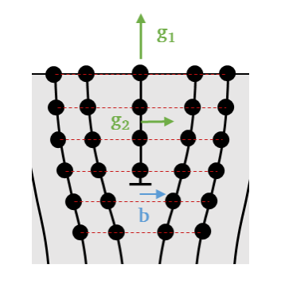
Transmission Electron Microscopy
TEM imaging
Diffraction contrast
Diffraction contrast: defects characterization
No strain of horizontal planes: no contrast on DF using the corresponding diffraction spot g₁
Strain on vertical planes: contrast on DF using the corresponding diffraction spot g₂
Extinction rules for a defect with a displacement field R:
g.R= n integer => no contrast
g.R ≠ n => contrast

Slide 81
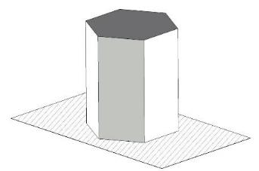
Transmission Electron Microscopy
TEM imaging
Diffraction contrast: defects characterization
Extinction rules for a defect with a displacement field R
g.R= n integer => no contrast
g.R ≠ n => contrast
a
a = 1/3<11-20>
c = <0001>
a+c = 1/3<11-23>
g/b | a= 1/3 <11-20> | c= <0001> | a+c = 1/3 <11-23>
{11-20} | contrast | Out-of-contrast | contrast
{0002} | Out-of-contrast | contrast | contrast
c
a+c
Dislocations in III-N

Slide 82
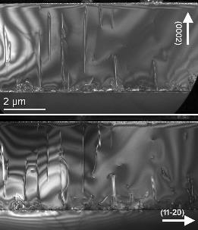


Transmission Electron Microscopy
TEM imaging
diffraction contrast
g/b | a= 1/3 <11-20> | c= <0001> | a+c = 1/3 <11-23>
{11-20} | contrast | Out-of-contrast | contrast
{0002} | Out-of-contrast | contrast | contrast
Close to <1-100> zone axis
(0002)
300nm
(0002)
(11-20)
a-type
a+c-type
c-type
MOVPE GaN on sapphire:
Most of dislocations are a+c type
2 a-type
(11-20)
a
b

Slide 83

Transmission Electron Microscopy
High resolution-TEM imaging
-g
0
g
Thickness (nm)
GaN (11-20)
HR-TEM imaging: image simulation required

Slide 84

Transmission Electron Microscopy
Scanning TEM

Slide 85
Transmission Electron Microscopy
Scanning TEM
Adjustment of the detection angle playing with the diffraction magnification (camera length)
ADF: diffraction contrast
HAADF: Z contrast
I≈ Z²
ADF+HAADF
HAADF
Annular detector 1
Annular detector 2
HR-HAADF images directly interpretable
High convergence angle: high resolution

Slide 86
Transmission Electron Microscopy
(Scanning) transmission electron microscope:
HT: 30 to 300kV; 200-300kV for material science; low HT for fragile materials (2D)
Spatial resolution:
  non corrected: depends on the objective lens: 2-2.5Å
  Aberration corrected (probe or objective): below 1Å
EDX
EELS
In-situ holder (heating , biasing, gas, liquid….)
….

Slide 87


Transmission Electron Microscopy
CRHEA’s ACT-M SPECTRA 200 technical characteristics
Cold FEG: small coherent and intense beam: high spatial resolution for imaging and chemical analyses
Operating voltages: 200, 120 et 60 kV: large range of observable samples
Probe-corrected for high resolution in STEM -mode: 200kV= 70pm; 120kV: 90pm; 60kV: 110pm
High sensitivity EDX (detection solid angle: 1,8sr): high resolution chemical analyses and chemical maps
4D STEM with NANOMEGAS ASTAR module
https://www.crhea.cnrs.fr/ACT-M/
Ileana.florea@crhea.cnrs.fr

Slide 88


Transmission Electron Microscopy
Scanning TEM
AlGaN2
HAADF
Z contrast
AlGaN1
20µm
GaN
2µm
GaN pillar
ADF
Diffraction contrast
L. Lacomblez, P.M. Coulon (CRHEA); M. Cabié (IM2NP Marseille): FIB sample preparation

Slide 89

Transmission Electron Microscopy
Scanning TEM: HR-HAADF
Direct projection of the structure
GaN (0001)
(S)TEM image: 2D image of a 3D object

Slide 90


Transmission Electron Microscopy
Scanning TEM: EDX

Slide 91

Transmission Electron Microscopy
Scanning TEM: EDX
Quantitative EDX:
  Cliff-Lorimer method: C_{A}/C_{B} = k・I_{A}/I_{B}
Ga: 18%; Al:82%
Ga: 85%; Al:15%
EDX: Ga: 18%; Al: 82%
Strain from XRD: Ga: 17%; Al: 83%
Ga: 24%; Al:76%

Slide 92

Transmission Electron Microscopy
Electron energy loss spectroscopy
Inelastic interaction: energy loss of e⁻ => spectrum
Low-loss (< ≈ 50eV):
  Dielectric response
  Free electron density
  Band gap
  Specimen thickness determination
See M. Amato presentation for an example

Slide 93
Transmission Electron Microscopy
Electron energy loss spectroscopy
Inelastic interaction: energy loss of e⁻ => spectrum
High loss (core loss): characteristic edges
    Composition determination (low Z elements)
    Bonding/valence state
    Nearest-neighbor atomic structure
https://eels.info/about/overview

Slide 94

Transmission Electron Microscopy
Electron energy loss spectroscopy
Ti_{L12}
La_{M45}
Sr_{L23}
Mn_{L23}
https://www.gatan.com/atomic-level-eels-mapping-using-high-energy-edges-dualeels-mode

Slide 95
Transmission Electron Microscopy
HR-(S)TEM
Interface analysis
AlN
Distance beetwen misfit dislocations for a complete prelaxation complète:
D = d_{c}d_{s}/(d_{s}-d_{c})
AlN/Si(111): 5 AlN planes/ 4 Si planes: complete relaxation
Si(111)
N. Mante et al., J. Appl. Phys, 123, 715201(2018)
FFT highlighting dislocations

Slide 96

Transmission Electron Microscopy
HR-(S)TEM
Interface analysis
A-plane_{ZnO} on R-plane_{saph}

Slide 97


Transmission Electron Microscopy
HR-(S)TEM
Strain analysis
AlGaN2
AlGaN1
GaN
AlGaN/AlGaN multi quantum well
geometrical Phase analysis (GPA) strain map

Slide 98






Transmission Electron Microscopy
HR-(S)TEM
Defect analysis
AlN/Si MBE
III-N layers microstructure
w
Plan view observation
h
Columnar microstructures (h>>w) dominated by twist
F.A. Ponce Group III Nitride Semiconductor Compounds, Physics and Applications (Clarendon Press, Oxford 1998).
S. Renesson, F. Semond (CRHEA)
Rotation map from geometrical Phase analysis (GPA)

Slide 99


Transmission Electron Microscopy
HR-(S)TEM
Defect analysis
b
8
9
b
8
a₂
9
9
Rotation map
8
a₁
9
8
Misorientation between subgrains compensated by the introduction of a-type edge dislocations

Slide 100
Transmission Electron Microscopy
Scanning TEM: EDX
Atomic scale EDX
O
Sr
Fe
La
Ti
SrLaFeO₃
SrTiO₃
A. Polfelski, Brookhaven National Laboratory (US), Mc Master University(Canada)

Slide 101

Transmission Electron Microscopy
Imaging light elements
HAADF: I≈ Z² => difficult to see both heavy and light atoms
1. I. Lazić, E.G.T. Bosch, Advances in Imaging and Electron Physics 199 (2017) 75-184.
2. E. Yücelen, I. Lazić, E.G.T. Bosch, Scientific Reports 8 (2018) 2676.
Shifted
diffraction
pattern
D
C
A
B
Integrated differential phase imaging: iDPC

Slide 102




Transmission Electron Microscopy
Imaging light elements
AlN/NbN/AlN heterostructures
Z_{N}=7; Z_{Al}=13; Z_{Nb}=41
N-polarity
N-polarity
AlN
NbN
AlN
Nb
Al-polarity
N
iDPC image
Al-polarity
HAAADF image
Al
A. Pédèches, H. Rotella, F. Semond (CRHEA)

Slide 103
Transmission Electron Microscopy
4D STEM
Ophus C (2019) Microsc Microanal. doi:10.1017/S1431927619000497
Improvement of diffraction patterns with precession
Nanomegas solution

Slide 104


Transmission Electron Microscopy
4D STEM

Slide 105
Transmission Electron Microscopy
4D STEM
Applications:
    Comparison of experimental diffraction patterns with a library of calculated ones
      Phase mapping
      Orientation mapping
      Strain mapping at mesoscopic scale
ε_{xx}
N. Mante, PhD thesis Grenoble 2016

Slide 106
Transmission Electron Microscopy
Sub Angstrom resolution => direct imaging of atomic columns: unsurpassed spatial resolution
Structural and chemical imaging
Localized information
Study in direct and reciprocal space
Requires time consuming sample preparation
Destructive

Slide 107
Transmission Electron Microscopy
Basic
Direct space | Reciprocal space
AFM; SEM SE imaging | XRD θ/2θ
SEM EDX/ECCI … | XRD RSM, φ scans ….
(S)TEM | XRD; (S)TEM
Non destructive
destructive
Advanced
Don’t hesitate to contact specialists when you want to perform/understand advanced characterizations

Slide 108

Merci pour votre attention!

Slide 109
Atomic force microscopy
KPFM (Kelvin probe Force Microscopy)
Schematic diagram of the Kelvin method
KPFM: by applying a voltage between tip and sample, we can cancel out the tip/sample potential difference and determine the local difference in output work between tip and sample
Tapping mode
Simultaneous acquisition of a topographic image and an image of the work output
Information on local composition and surface electronic structure
By Sraisac - Own work, CC BY-SA 4.0, https://commons.wikimedia.org/w/index.php?curid=79006406
https://www.bruker.com/fr/products-and-solutions/microscopes/materials-afm/afm-modes/kpfm.html

Slide 110
Scanning Electron Microscopy
EDS in cross section
substrate
substrate
Use a thin sample
(TEM or transmission in a SEM)

Slide 111
Scanning Electron Microscopy
ECCI
MOVPE-grown GaN/Si
A. Mandal et al., Microscopy and Microanalysis, 2024, 00, 1–14

Slide 112

Atomic force microscopy
Evolution of MoS2/GaN MBE growth as a function of time
30’
Nucléation
rms: 0,13nm
1h
rms: 0,26nm
Lateral triangular growth
2h
rms: 0,32nm
3h
coalescence
M. Al Khalfioui et al., J. of Cryst. Growth 652 (2025) 128047
rms: 0,2nm

Slide 113
Scanning Electron Microscopy
EBSD
µLED fabrication

Slide 114
X-Ray diffraction
Grazing incidence Xray diffraction; in plane diffraction: study of planes perpendicular to the surface
2θ
Detector
θ

